Slide 1
Kakinada property
Vamsee

Slide 2
Plot location
Plot is located in Ramanayapet, Kakinada Andhra Pradesh
Site is adjacent to 30’ road, which is connecting Stadium road and Veg market road
Very close to JNTU Kakinada by 1.4 km
Site area is apprx 1100 sqyards

Slide 3
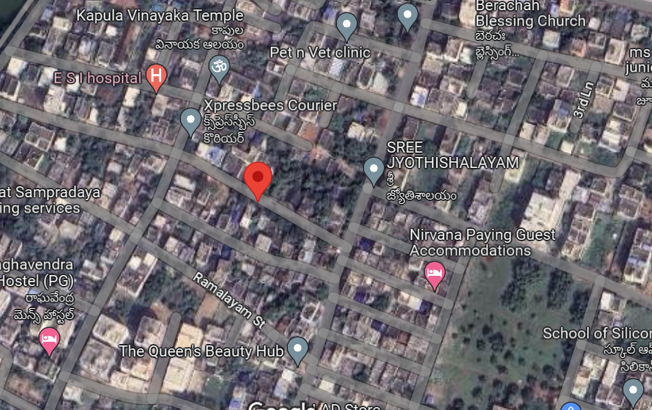


Plot details

Slide 4
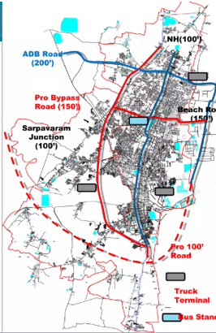
Kakinada Connectivity
By road
Kakinada town is connected by NH-216 from kathipudi – ongole
SH-40 connects Rajahmundry
ADB and samalkot- Kakinada bypass road
By air
Rajahmundry (61km away)
Visakhapatnam (145km away)

Slide 5
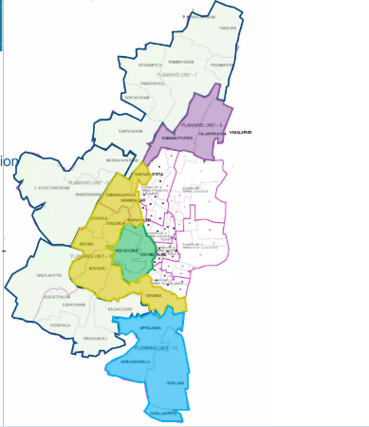
Zoning of kakinada
Fishing and other related activities
Commerce related activities
Industrial related activities
Agriculture related activities

Slide 6
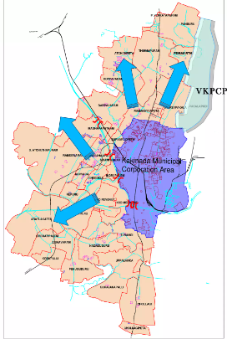

Ramanayapeta
Municipal Corporation of Kakinada expansion

Slide 7
SWOT Analysis
Strength :
Site is secured with a boundary wall
Site is approachable with 30’ road access
Existing power connection available
Municipal and borewell connections are available for continuous water supply
Weakness :
Temple at the end of the street hinder further expansion of road
Site is partially occupied.
Site is not perfectly rectangle / square. May provide constraints in planning
Now the site is in within the municipal corporation limits. Conversion is required.
Opportunity
The locality is a developing locality. Hence the sale prices of the particular locality is on rise
No hindrance for construction / development.
Threat
Road is 30’ restrict the construction of upper floors
Site is in multiple family holding, may impact the development

Slide 8
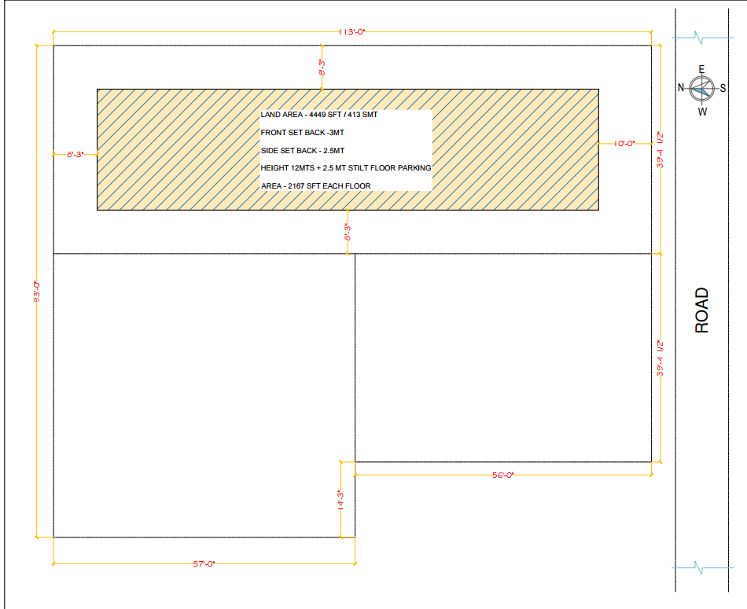
Existing house

Slide 9
Option 1
Assumptions
Site measurements are as per drawing
Site setbacks considered as per the bye laws
Number of floors permissible 4
Transfer development rights (TDRs) can be purchased from the govt., to increase builtup area. However, it is not considered in present calculation. (TDRs are issued by govt to increase builtup area. These TDRs are to be purchased from govt. )
Deviation tolerance not captured in the calculation
Construction costs considered on medium range house 2250/sft.
The construction cost does not include statutory fees taxes and other conversion fees / liaisoning etc.
Cost of construction does not include any interiors
Saleable price: As per the ground discussion and data collection. ( considered on the lower side). The average ticket size is 60 -70 lacs for 3 BHK and 40-50 lacs for 2BHK

Slide 10
Option1: recommendations
Due to split within the plot, a significant portion of land will be unutilised due to setback requirements.
The width of developed property is hardly 22 ft , which may constrain flat/ room dimensions.
Entry of the flats are most likely in north and south direction. It may have impact on the sales . (East and west facing are on high demand in the area.)
Development requires new water and power connections
The existing house to have alternate route for exit.

Slide 11
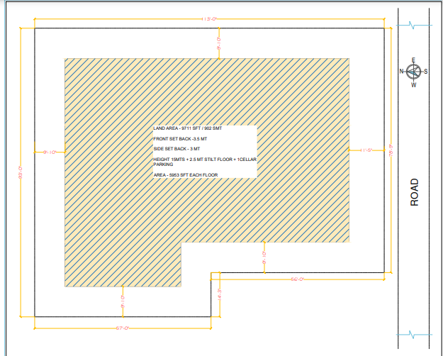
Option 2

Slide 12
Option 2
Assumptions
Assumptions as per earlier option 1
Cost of construction increased by Rs. 100/ sft since the number of floors increased from 4 to 5.
Selling price increased as the width of each block is more and number of flats are more. Hence more number of people.
Since it is a large area development, the selling price is considered on higher side compared to option 1.
Saleable area / builtup area is considered 0.8 compared to earlier option as the distance between the bocks to be left for ventilation purpose (apart from corridor and staircase)
Openings can be provided on East/ west with corridor spacing, thus possibility of quick closure of sales.
Family needs to shifted before construction. The costs of shifting to new location not considered.

Slide 13
Option2 : recommendations
Considering the value generated, It is recommended to go plan for property development to arrive at the benefits of extra floor

